Slide 1
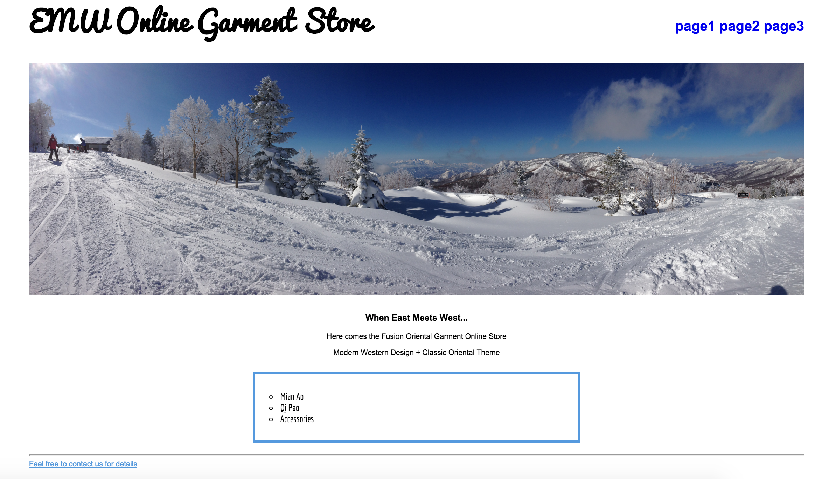

Slide 2
Logo
NAV
NAV
NAV
NAV
Banner Photo
Product 1
Photo
Product 2
Photo
Product 3
Photo

Slide 3
NAV
NAV
Logo
NAV
NAV
Banner Photo
Product 1
Photo
Product 2
Photo
Product 3
Photo

Slide 4
Logo
Product 1
Photo
Product 1
Photo
Product 1
Photo

